Slide 1
Phase - 1
Choose a dataset from below two resources
https://catalog.data.gov/
https://www.kaggle.com/datasets
Choose dataset that way so it could be used for normalization. If the dataset is already normalized or cannot be used for normalization, they cannot be used for the project. (Deliverable 1.1)
All datasets will need to be presented to the professor and should be approved for the project before you start working on it. (Before end of Week 6)
Find all functional dependencies, minimum cover and normalize the datasets to the 3NF. (Deliverable 1.2)
Create logical data model and ER (Deliverable 1.3)
Create physical data model for all entities. (Deliverable 1.4)
Create DDL statement (Deliverable 1.5)
Create physical tables in the SQL Server database (Deliverable 1.6)

Slide 2
Choose dataset that way so it could be used for normalization. If the dataset is already normalized or cannot be used for normalization, they cannot be used for the project. (Deliverable 1.1)
All datasets will need to be presented to the professor and should be approved for the project before you start working on it. (Before end of Week 6)
The Selected Dataset for the Project is Border Gavaskar Trophy (India vs Australia tests).
The Link of the Dataset is BGT.

Slide 3
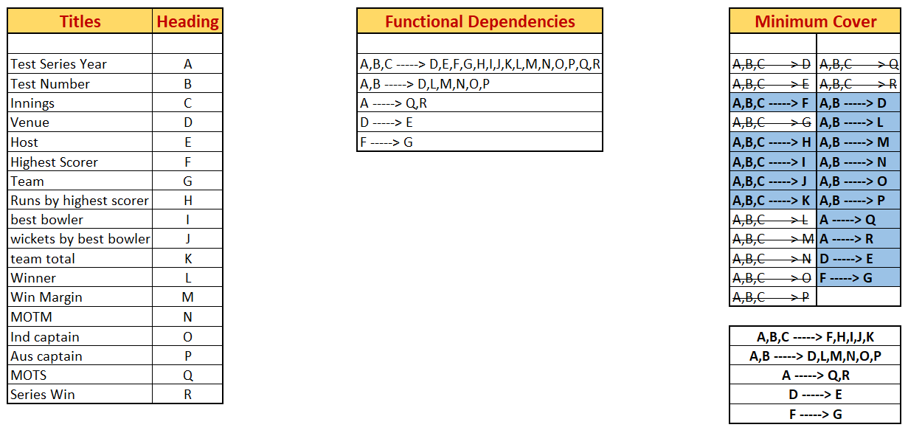
Find all functional dependencies, minimum cover and normalize the datasets to the 3NF. (Deliverable 1.2)
For this Dataset we can use Test Series Year (A), Test Number (B), and Innings (C) as a Super Key.

Slide 4
Find all functional dependencies, minimum cover and normalize the datasets to the 3NF. (Deliverable 1.2)
Minimum Cover
Q
R
D
E
G
F
L
A
H
M
I
B
N
J
O
C
K
P

Slide 5
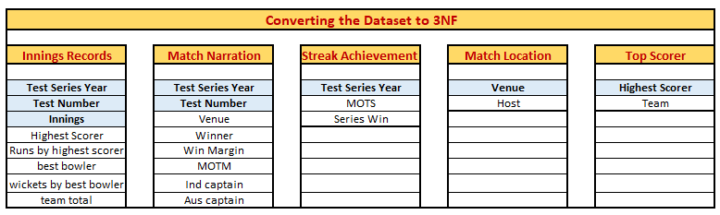
Find all functional dependencies, minimum cover and normalize the datasets to the 3NF. (Deliverable 1.2)
Note: Highlighted in Blue are the Primary Key of that table

Slide 6
The Final Relations
Find all functional dependencies, minimum cover and normalize the datasets to the 3NF. (Deliverable 1.2)
Match Location: Provides the details as to where the matches have been held over the years and who has hosted it.
Streak Achievement: Provides a briefing for each series of test matches.
Match Narration: This relation contains data that relates to the individual test matches.
Top Scorer: This relations holds a list of top scorers and their respective teams.
Innings Records: This relation hold the finer details of a test match corresponding to the innings.

Slide 7
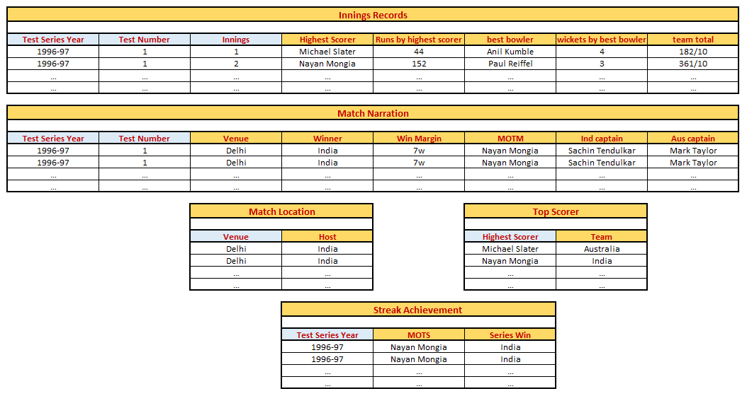
Find all functional dependencies, minimum cover and normalize the datasets to the 3NF. (Deliverable 1.2)
Note: Highlighted in Blue are the Primary Key of that table

Slide 8
Find all functional dependencies, minimum cover and normalize the datasets to the 3NF. (Deliverable 1.2)
Innings Records
Primary Key - Test Series Year, Test Number, Innings
Match Narration
Primary Key - Test Series Year, Test Number
Foreign Key - BGT Records (Test Series Year, Test Number)
Match Location
Primary Key - Venue
Foreign Key - Match Narration (Venue)
Top Scorer
Primary Key - Highest Scorer
Foreign Key - BGT Records (Highest Scorer)
Streak Achievement
Primary Key - Test Series Year
Foreign Key - BGT Records (Test Series Year)

Slide 9
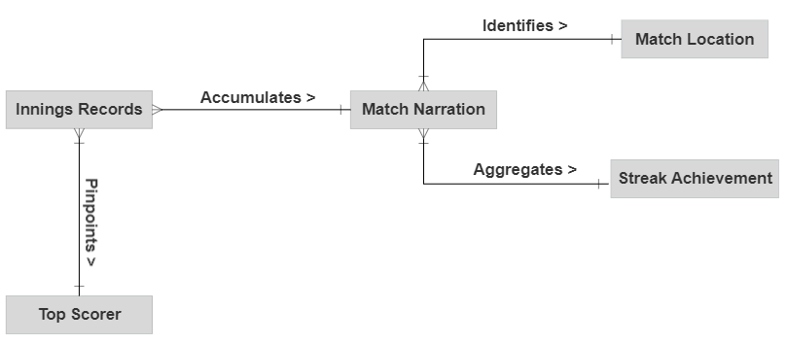
Create logical data model and ER (Deliverable 1.3)
Conceptual Data Model

Slide 10
Create logical data model and ER (Deliverable 1.3)
Conceptual Data Model (cont..)
Every individual innings (contained in ‘Innings Records’) point out a Top scorer for the innings (contained in ‘Top Scorer’). This is a many-to-one relation, since different innings can have the same player scoring the highest, but each innings can have only one highest scorer.
All details of the individual innings (contained in ‘Innings Records’) are combined to obtain the match results and analysis (contained in ‘Match Narration’). However, the team captains are pre-established. This is a many-to-one relation too, since multiple innings belong to a single test match, however a particular innings corresponds to exactly one test match.
The information from the test matches (contained in ‘Match Narration’) provides insight on the test series such (as contained in ‘Streak Achievement’), and also reveals the location for the match (contained in ‘Match Location’). These relationships are also many-to-one.
Let us take the ‘Streak Achievement’ relation. A typical series has around 1-4 test matches played, varying each year. However, a single test match is not played over multiple years. It is played within a single year.
The same goes for ‘Match Location’. One or many test matches may be hosted at the same venue, depending on its popularity. However, a test match cannot be held at two different locations.

Slide 11
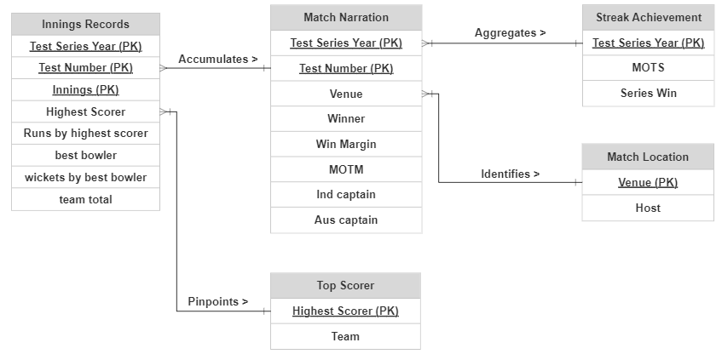
Create logical data model and ER (Deliverable 1.3)
Logical Data Model

Slide 12
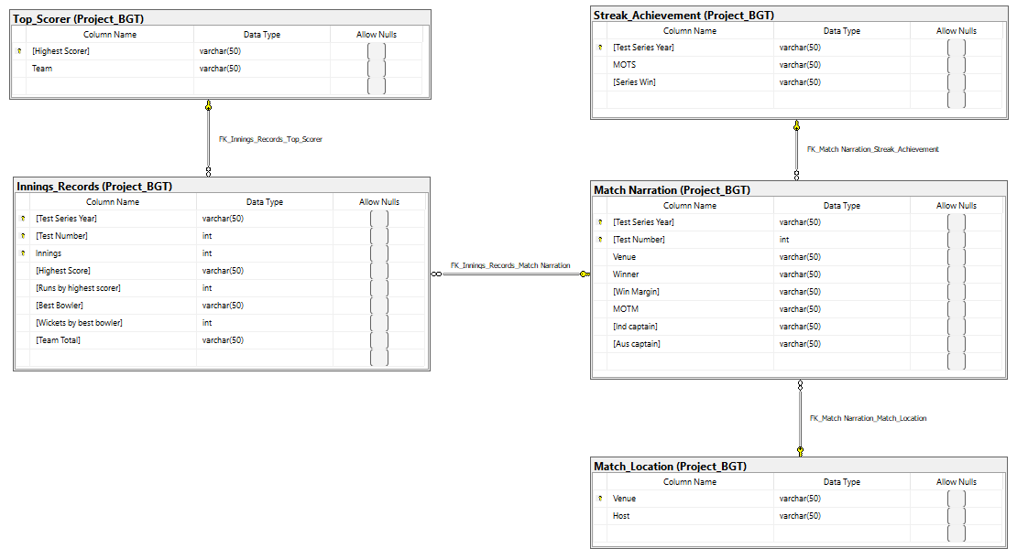
Create physical data model for all entities. (Deliverable 1.4)

Slide 13
Create DDL statement (Deliverable 1.5)
The DDL Statement is uploaded separately as it is an SQL file.
The File name updated in Canvas is DDL statement - Deliverables 1.5

Slide 14
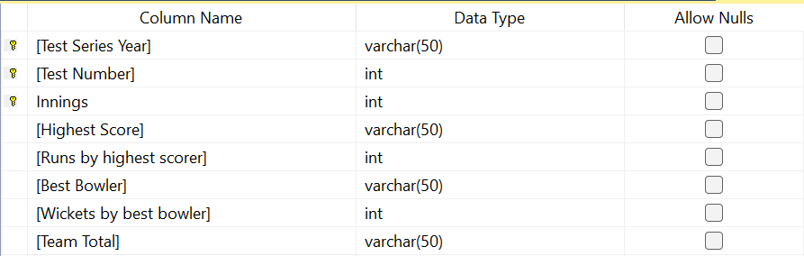
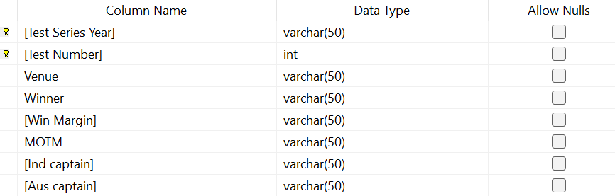
Create physical data model for all entities. (Deliverable 1.6)
Innings Records
Match Narration

Slide 15

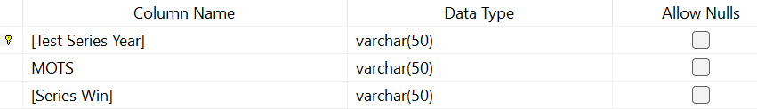

Create physical data model for all entities. (Deliverable 1.6)
Match Location
Streak Achievement
Top Scorer

Slide 16
Create physical data model for all entities. (Deliverable 1.6)
The DDL Statement for all the table is uploaded separately as it is an SQL file.
The File name updated in Canvas is DDL statement Innings Records - Deliverables 1.6, DDL statement Match Narration - Deliverables 1.6, DDL statement Match Location - Deliverables 1.6, DDL statement Streak Achievement - Deliverables 1.6, & DDL statement Top Scorer - Deliverables 1.6

